Slide 1
Cheap Sell
Group 18
Akinori Kahata
Jincheng Yang
Shijie Wu
Md Shahjalal

Slide 2
Language of Our Project: Groovy
Object Oriented
Imperative
Scripting
Dynamic (Can be mark Static Compile)
Functional
Testing
Easy Kickstart/Learning

Slide 3
Performance
 | Groovy | Java | Time Faster
Simple Counter | 8.45 | 0.15 | 56x
Binary Tree Building | 19.5 | 2.58 | 7.6x
Binary Tree Traversal | 2.53 | 0.76 | 33x
Prime Number Detection | 43.27 | 1.17 | 37x

Slide 4
Runtime comparison
Joshepus problem per iteration in microsecond
C++ ~0
Java 1.6
Ruby 89
Groovy 104
Python 192

Slide 5
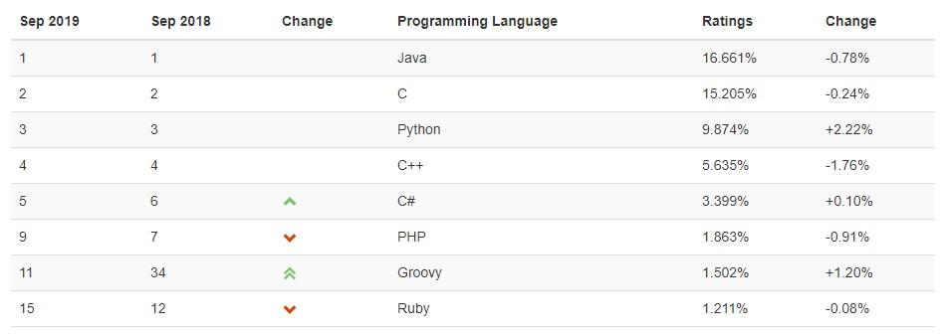
TIOBE Index: 34(2018) → 11(2019)

Slide 6
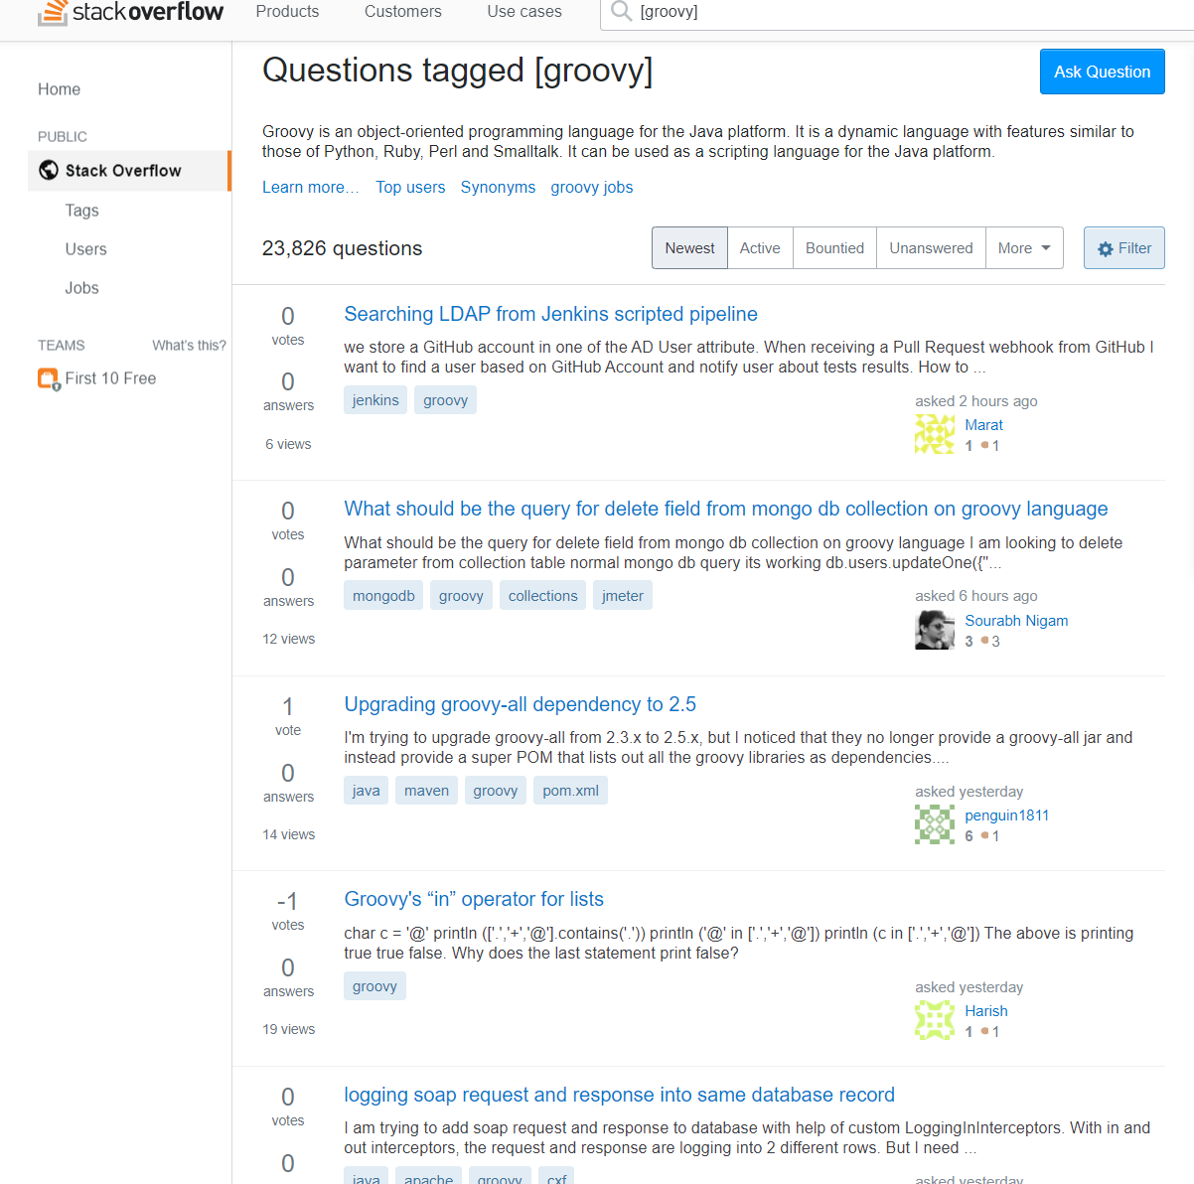
Groovy on stackoverflow
Java has 1,589,231
recent questions

Slide 7
# of Public repository at GitHub (Topic)
Groovy 1,270
C++ 18,709
C 22,269
C# 22,230
Java 87,130
Python 117,159

Slide 8
# of Opensource Web Framework
Groovy ~6
Grails/Spock/GPars/GRIFFON/GEB/MICRONAUT
Java > 1003
Python < 100⁴

Slide 9
Job posted in LinkedIn
Groovy ~ 19706
C++ ~ 165353
C# ~ 203036
Python ~ 301395
Java ~ 432454

Slide 10
Book found on Amazon
Groovy ~ 67
C# > 1000
Python > 2000
C++ > 5000
Java > 7000

Slide 11
Purpose
Helping upcoming students to buy cheap/used furniture
As well as existing ongoing student to sell
Buy and sell old furniture in cheap price (Limit ~100, you may call it 100$ shop)
Targeted for college/university student and people with budget
Shipping management on low cost (By shipping multiple items and order of multiple buyers together)

Slide 12
Data
Seller Profile
Buyer Profile
Product Profile
Shipping Company Information
Credit Card Information

Slide 13
Business Function
Create Buyer/Seller profile
Create Product profile
Verify Buyer/Seller
Instant buy/sell by credit card/bank account
Coordinating Shipping system for low cost
Option for auction with base price
Hold big end of school year sell season
Bulk buy/sell option
Price estimation
Maintaining Wishlist (Notify when item from wishlist available)
Connectivity with university website (If they want)

Slide 14
Tools
System will be implemented using Groovy language
Grails framework
Address verification by smartystreets api
Code management by git
Gradle for build
Data access toolkit: GORM
Service side view rendering: Groovy Server Pages (GSP)
Repository management by GitHub
Tomcat Server
Hibernate (SQL)

Slide 15
High Level Architecture - Components
Seller
Name
Address
Phone number
Email
Photo
Rating
History
Photo Id
Credit Information
Buyer
Name
Address
Phone number
Email
Photo
Rating
History
Photo Id
Credit Information
Wish List
Product
Name
Picture
Asking Price Negotiable
Shipping option
Date of Purchase Usage
Condition
Description: Size, Weight, Color, Material

Slide 16
High Level Architecture - Components
System
User Profile
User Verification
(address/phone/email/Credit Card)
Product Profile
Product Search
Product Display
Login Management
Security Maintenance
Transaction Management
Dispute Management
Shipping Management
Wishlist Management

Slide 17
High Level Architecture - Process
Seller
Post Product
System
Buying Order
Buyer
Deposit to Account
Charge Account
Shipping
Shipping
Personal Shipping

Slide 18
Reference
http://blog.dhananjaynene.com/2008/07/performance-comparison-c-java-python-ruby-jython-jruby-groovy/
https://www.tiobe.com/tiobe-index/programming-languages-definition/
https://java-source.net/open-source/web-frameworks
https://wiki.python.org/moin/WebFrameworks
http://www.codecommit.com/blog/java/groovys-performance-is-not-subjective
http://blog.websitesframeworks.com/2013/11/comparison-of-programming-languages-ruby-groovy-python-and-php-353/
https://dev.to/jcoelho/10-reasons-to-use-groovy-in-2019-431f
https://www.codementor.io/szymonstpniak/5-reasons-groovy-programming-language-is-still-a-valid-choice-in-late-2018-npogilod3
https://groovy-lang.org/style-guide.html

